Slide 1
Pedagogical Ability Assessment of AI-powered Tutors
Course Instructor
Dr. Maunendra Sankar Desarkar
Sk Nishat Saama, CS24MTECH12016
Devendra Kumar Dewangan, CS24RESCH11011
Veeresh Shukla, CS24MTECH14010

Slide 2
Outline
Exploratory Data Analysis
Data Preparation
Models
Fine Tuning
Loss Functions
Hyperparameter Tuning
Results

Slide 3
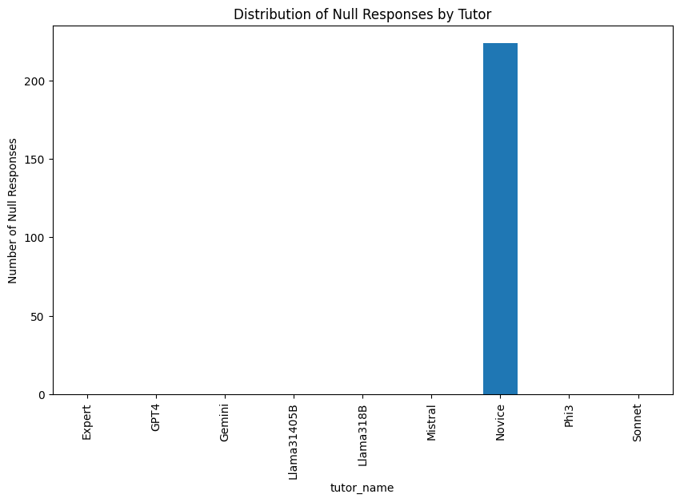
Exploratory Data Analysis

Slide 4
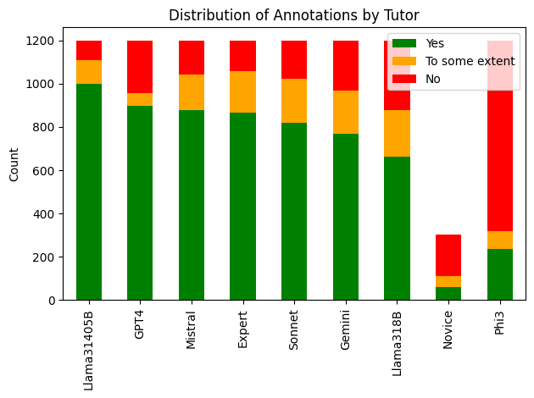

Slide 5
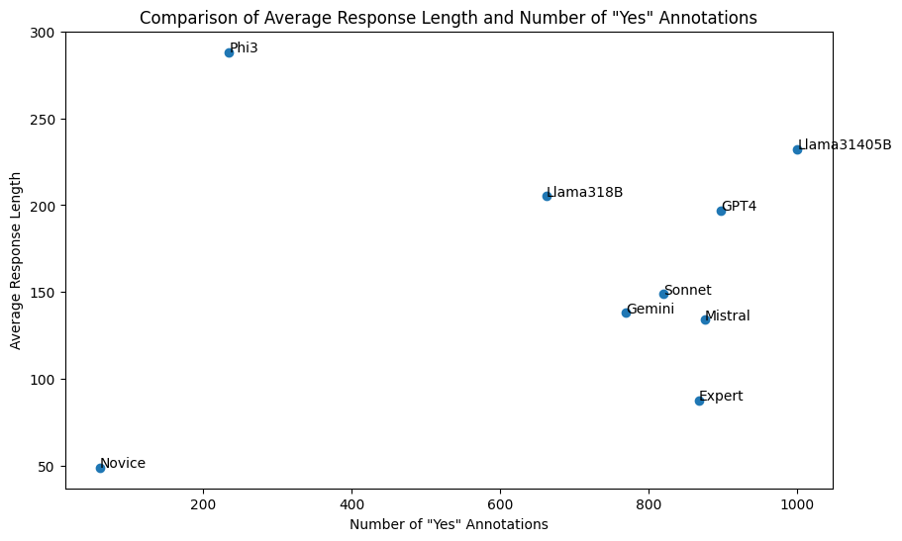

Slide 6
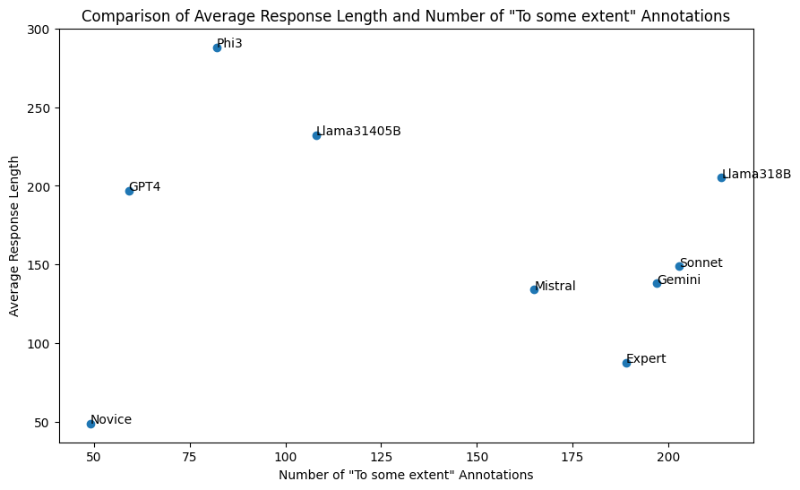

Slide 7
Data Preparation
Separating Dialogue History
Extracting the Core Question
Crafting the Model's Input
Converting to Numbers for Labels
Formatting so that it can be under 512 token limit
Train Validation Test Split

Slide 8
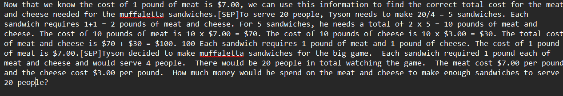
Prepared Data

Slide 9
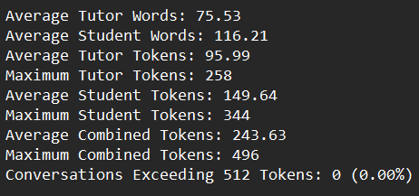

Slide 10
Models
BERT: base, 12 layers, 110 M parameters, 512 token size
RoBERTa: base, 12 layers, 110 M parameters, 512 token size
ModernBERT: base, 22 layers and 149 million parameters, 8192 token size

Slide 11
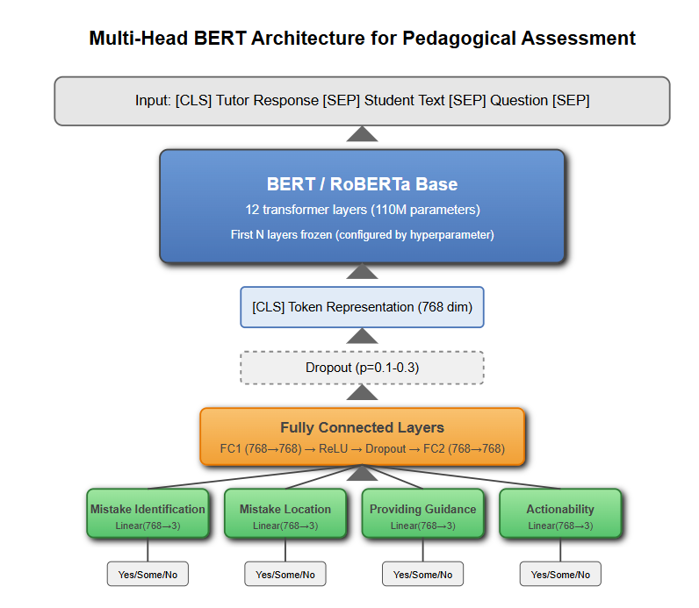
Models

Slide 12
Fine Tuning
Added 2 dense layers at the end of model before the final layer for adding non-linearity.
Used model freezing, freezed some of the layers of the model and made some layers trainable.

Slide 13
Loss Function
Cross Entropy Loss
Ordinal Cross Entropy Loss
Focal Loss
Focal Loss with task weights

Slide 14
Hyper Tuning
Params: RoBERTa Model
learning_rate: 2.4352796960051026e-05
batch_size: 8
dropout_rate: 0.1
freeze_layers: 6
fc_hidden_size: 1024
use_weighted_loss: True
id_weight: 1.4271065569828554
loc_weight: 1.0247356643310799
guide_weight: 0.8690676699308719
action_weight: 1.0640074262770733

Slide 15
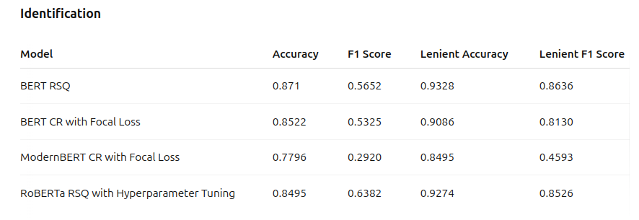
Results

Slide 16
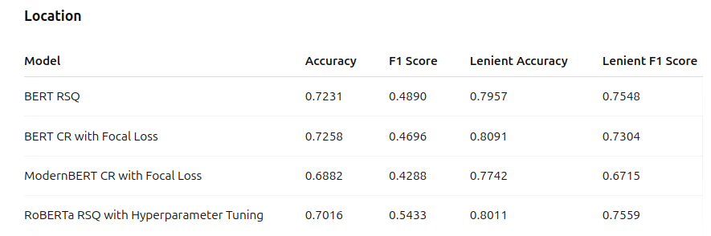
Results

Slide 17
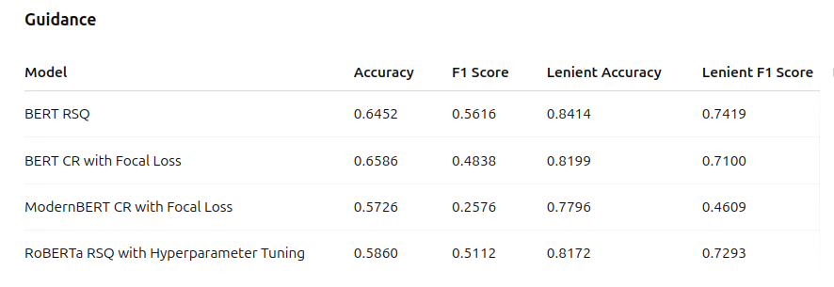
Results

Slide 18
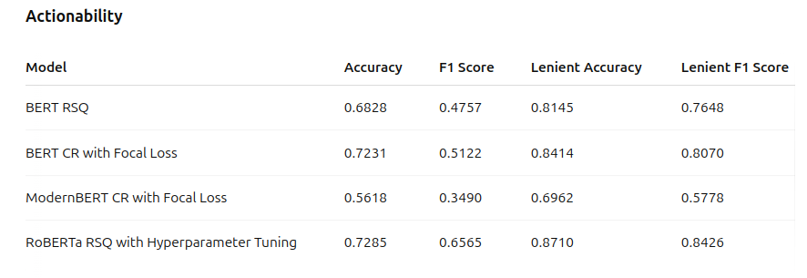
Results

Slide 19
Results
RoBERTa with hyperparameter tuning achieves the best overall performance, especially in critical F1 scores
RSQ ordering (Response+Student text+Question) consistently outperforms CR ordering (Conversation+Response)
ModernBERT significantly underperforms compared to both BERT and RoBERTa models
Highest performance improvement seen in Actionability dimension with RoBERTa (0.657 vs 0.476 F1 score)
RoBERTa shows improvement in exact F1 scores over the best BERT model

